Slide 1
IMAGE CLASSIFICATION
USING
CALTECH-256 DATASET
Dolly Yadav
Capstone Project March 2024
Notes:
Welcome everyone! Today we are here to discuss the exciting task of Image Classification using the Caltech-256 Dataset. With over 30000 images and 257 classes, this is a challenging but rewarding problem. Our goal is to build a machine learning model that can accurately classify images into their respective categories. Let's get started!

Slide 2
CONTENT
Introduction
Exploratory Data Analysis
Data Preprocessing
Model Architecture
Hyper Parameterization & Results

Slide 3
PROBLEM STATEMENT
OBJECTIVES
To study the dataset and perform Exploratory Data Analysis.
To preprocess the dataset with oversampling, under sampling and augmentation techniques.
To build and compare the results of hyper parameterization using ResNet18 and ResNet50 models.
To utilize and improve upon pre-trained deep learning models for the classification of Caltech-256 images and achieve a high accuracy final model.
3
Notes:
Welcome everyone! Today we are here to discuss the exciting task of Image Classification using the Caltech-256 Dataset. With over 30000 images and 257 classes, this is a challenging but rewarding problem. Our goal is to build a machine learning model that can accurately classify images into their respective categories. Let's get started!

Slide 4
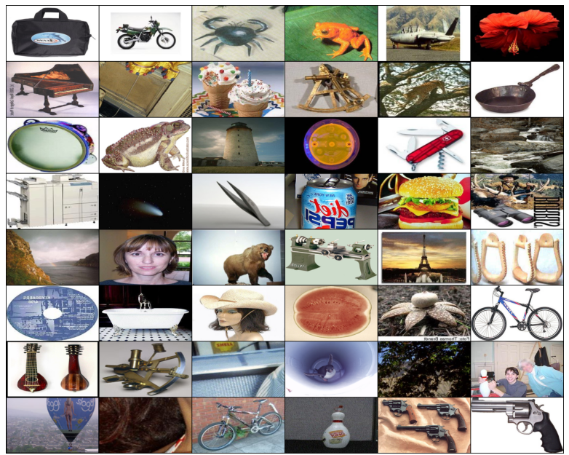
UNDERSTANDING THE CALTECH-256 DATASET
The Caltech-256 dataset is a collection of 30,607 images across 257 categories, with a minimum of 80 images per category.
The images are of varying sizes.
The dataset covers a wide range of objects, such as animals, vehicles, and natural objects.
Notes:
Before we dive into building our model, let's take a moment to understand the dataset. The Caltech-256 Dataset consists of over 30000 labeled images, split into 257 classes. Each image can be of varying sizes and can be in color or grayscale. It is important to understand the dataset before we start building our model so that we can make informed decisions throughout the process.

Slide 5
OVERVIEW OF IMAGE CLASSIFICATION
Image classification involves categorizing images into specific classes or labels.
The goal is to use and compare models that provide best accuracy in differentiating between different categories of images.
Techniques used pre-trained CNN models such as ResNet18 and ResNet50 and hyper parameter tuning.

Slide 6

EXPLORATORY DATA ANALYSIS

Slide 7
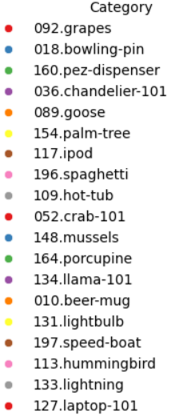
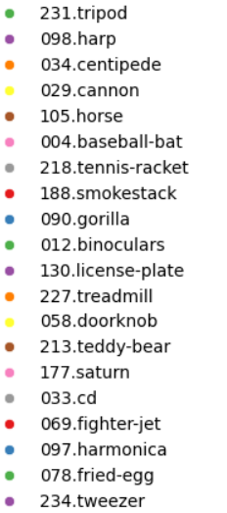
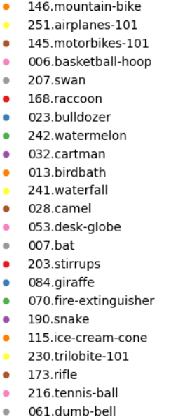
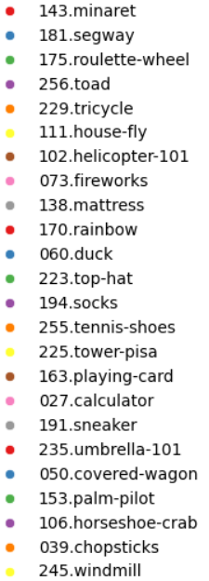
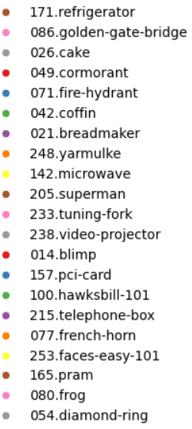
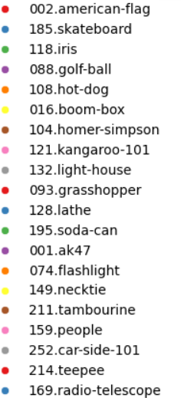
CATEGORIES OF IMAGES

Slide 8
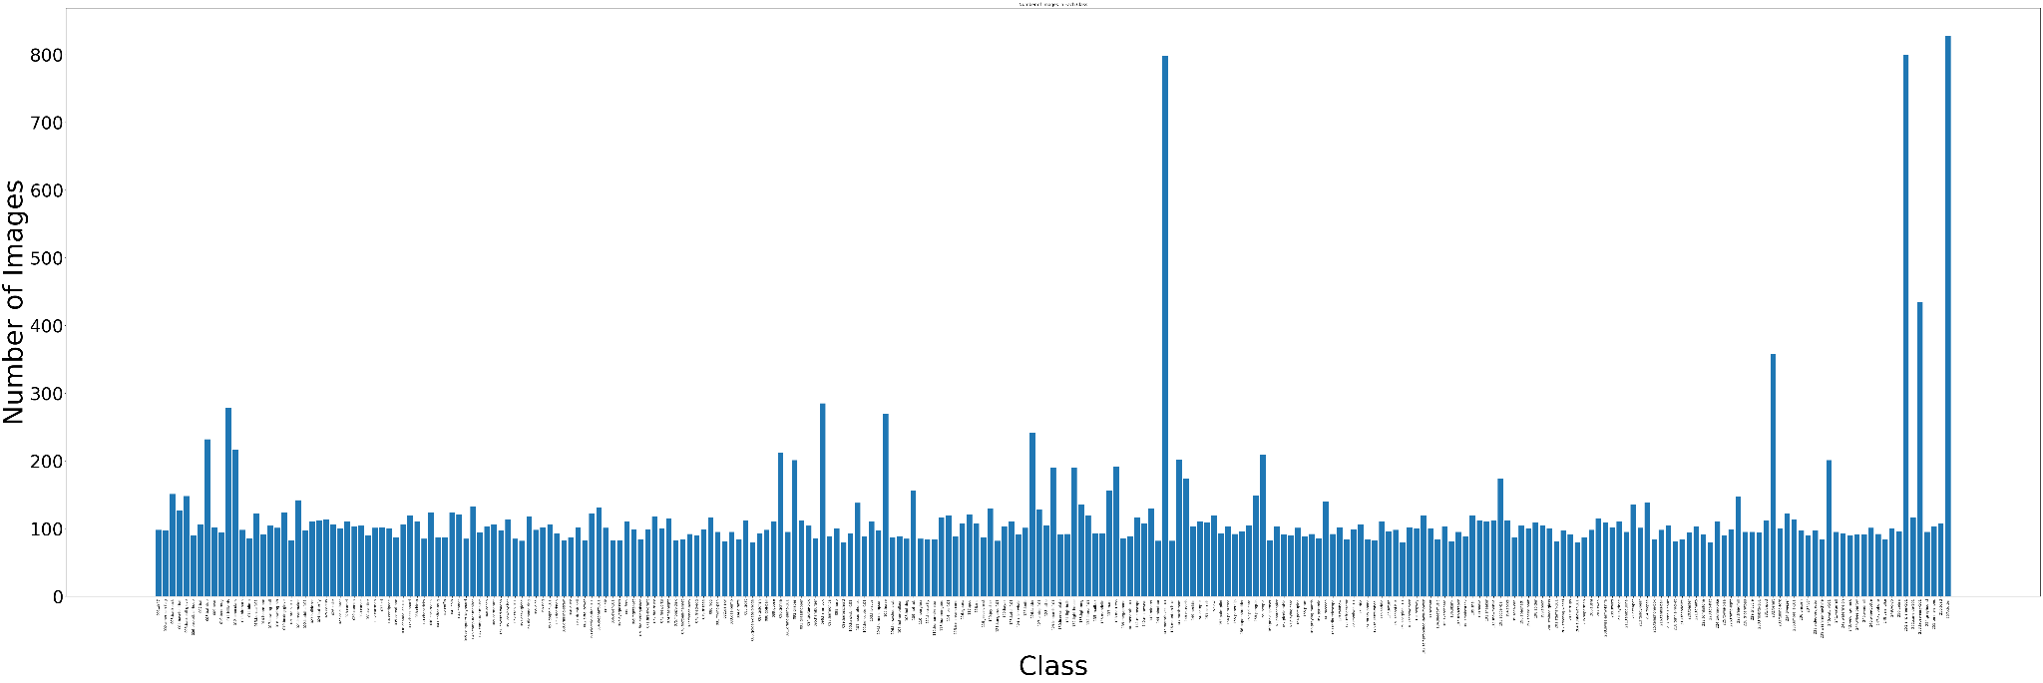
FREQUENCY DISTRIBUTION OF THE IMAGES IN DIFFERENT CLASSES

Slide 9
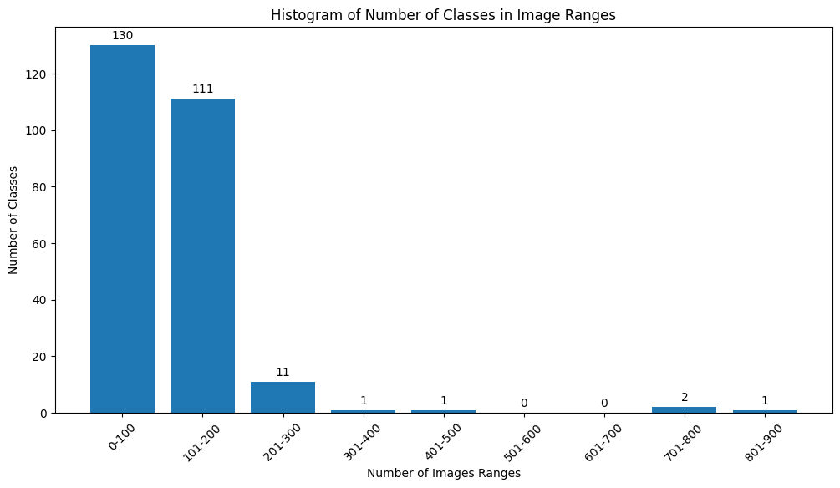
HISTOGRAM OF CLASSES IN VARIOUS IMAGE RANGES

Slide 10
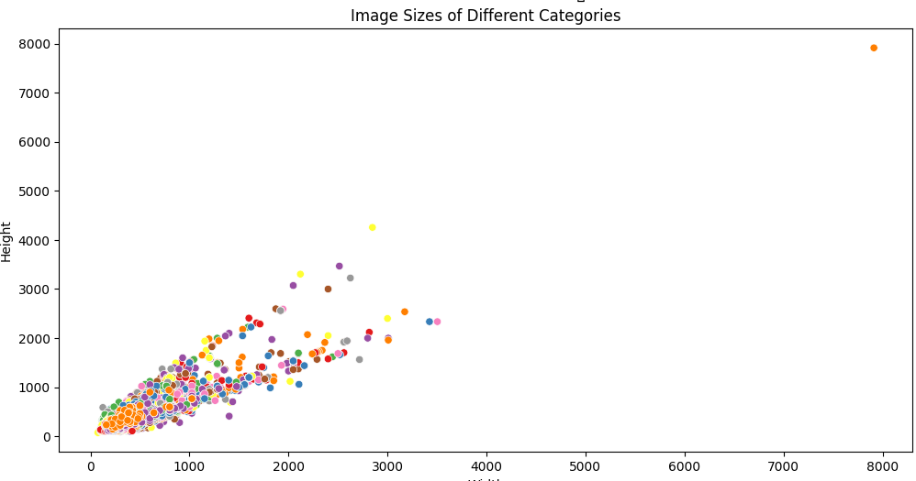
SCATTER PLOT OF IMAGE SIZES OF VARIOUS CLASSES

Slide 11
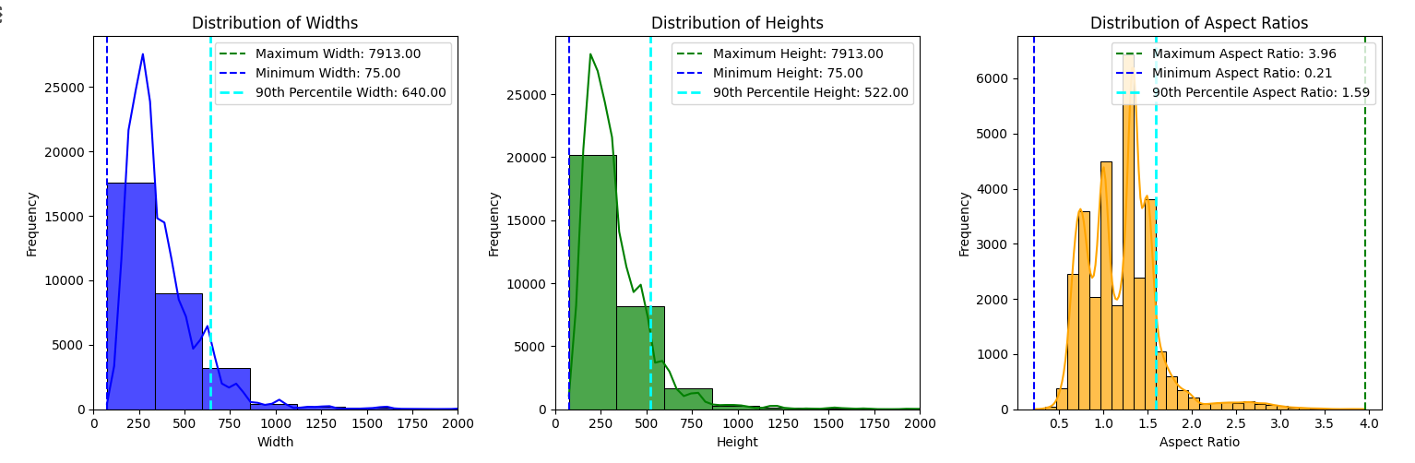
HISTOGRAM OF HEIGHTS, WIDTHS and ASPECT RATIOS.

Slide 12
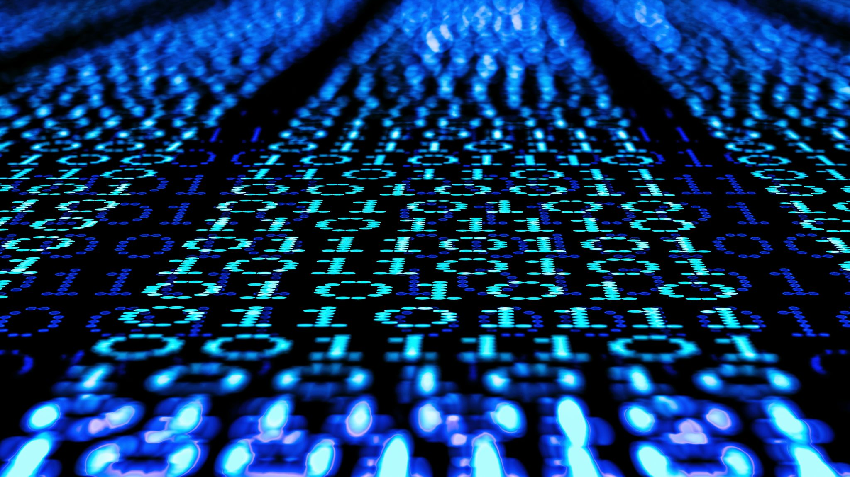
DATA PRE-PROCESSING

Slide 13
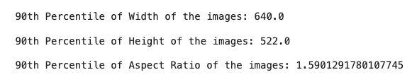
The images were resized to a 2^{x} size (512X512), nearer to 90th percentile of heights and widths (522X640).
Sampling Techniques (over and under) were used to solve class imbalance and create 200 images in each class.
Data Augmentation was used to transform and diversify the images.
The images were normalized based on the mean and standard deviation calculated for all 3 channels, to improve the model training and performance.
The dataset was split into training and testing, and for validation, testing dataset was used.

Slide 14
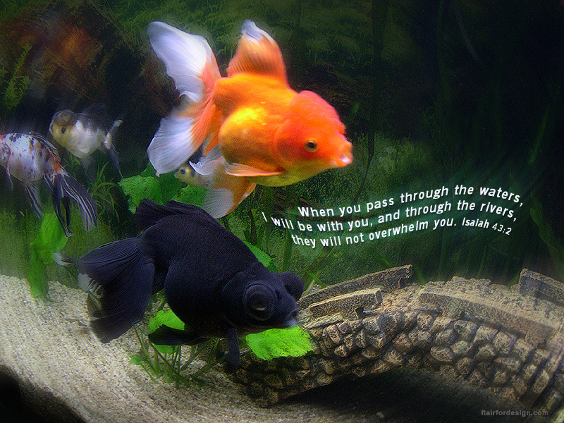
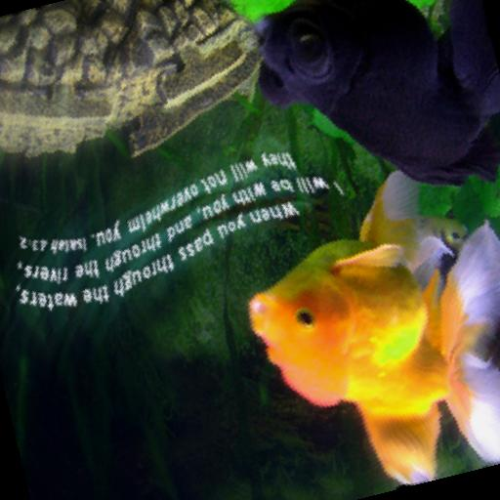
ORIGINAL AND AUGMENTED IMAGE - GOLDFISH

Slide 15
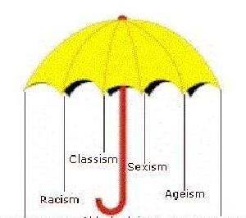
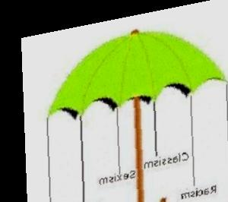
ORIGINAL AND AUGMENTED IMAGES: UMBRELLA

Slide 16
SAMPLES FOR TRAINING AND TESTING
Samples for training (80%) | 41,120
Samples for testing (20%) | 10,280
Total samples | 51,400

Slide 17

MODEL ARCHITECTURE

Slide 18
INPUT, OUTPUT AND LOSS FUNCTION
Input | Images and Labels
Output | Target Class among 257 categories
Loss Function | Categorical Cross Entropy

Slide 19
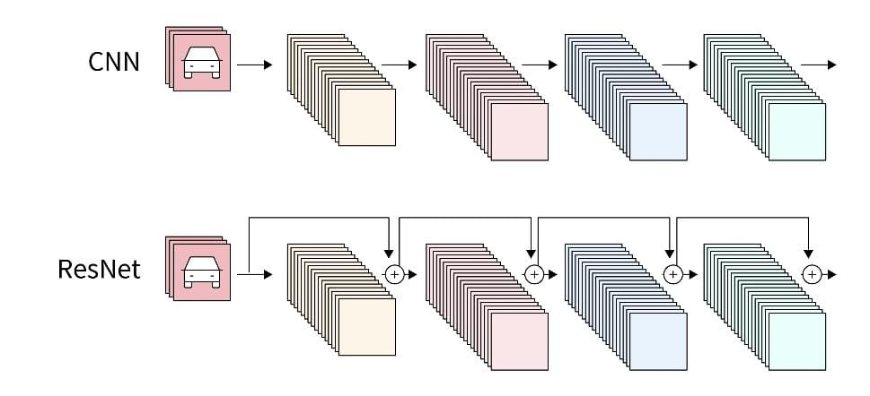
ResNet 18: ResNet-18 is a compact deep neural network architecture that introduced residual connections. These skip connections allow the network to learn residual functions, easing the training of very deep networks. With 18 weight layers, it strikes a balance between complexity and performance, making it popular for various computer vision tasks like image classification.
ResNet 50: ResNet-50 is a variant of Residual Neural Networks (ResNets), known for its depth with 50 layers. It introduces residual connections to address the vanishing gradient problem in very deep networks. These skip connections allow for easier training of deep networks by enabling direct information flow between layers, improving gradient flow and performance.
Notes:
We will use a convolutional neural network (CNN) for image classification. We will start with a simple model and gradually improve its performance using techniques such as data augmentation and transfer learning. The goal is to achieve a high accuracy on the testing set.

Slide 20
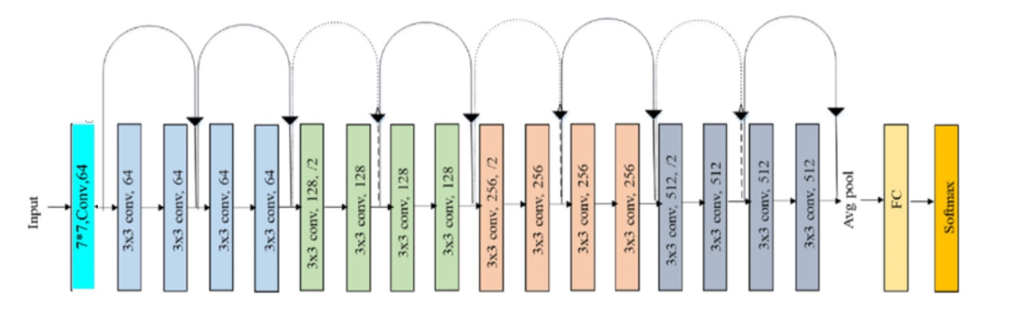
ORIGINAL ResNet18 ARCHITECTURE

Slide 21
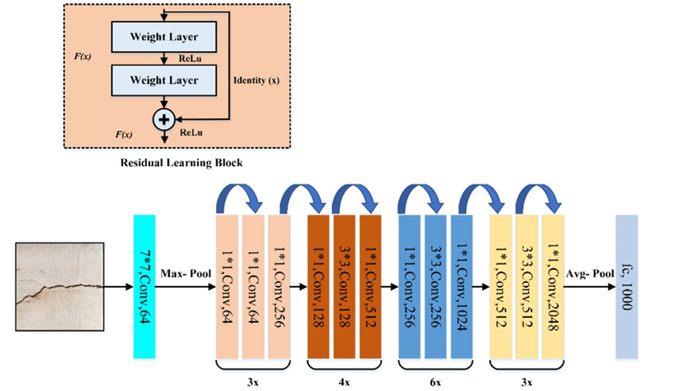
ORIGINAL ResNet50 ARCHITECTURE
257

Slide 22
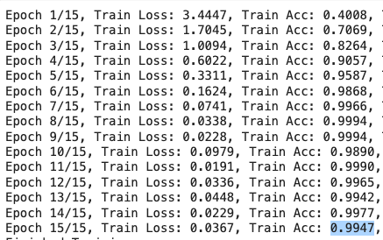
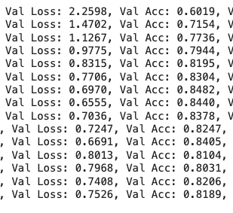
EVALUATING THE MODEL
Sample of ResNet18 Results
Evaluate the performance of our model using metrics like accuracy, confusion matrix, and classification report.
Fine-tune the hyperparameters to improve the performance of ResNet18 and ResNet50.
Compare the results of both the model architecture.
Notes:
Once we have built our model, we need to evaluate its performance. We will use metrics like accuracy and confusion matrix to assess the performance of our model. Additionally, we will fine-tune the hyperparameters to improve the performance. Finally, we will test our model on a set of unseen images to evaluate its real-world performance.

Slide 23
HYPER PARAMETRIZATION

Slide 24
RESNET18: HYPER PARAMETRIZATION AND ACCURACY
Hyper Parameters: Batch = 64 0.0001 LR 0.01 WD | Horizontal & Vertical Flips, Color Jitter (0,2, 0.2, 0.2, 0.1), Gaussian Blur (0.1,0.2), Random Affine (± 20 degrees, ± 0.2 translate, ±0.2 scaling, ± 10 shear) |  |  | + Random perspective (0.5 distortion) |  | + Gaussian Blur sigma=(0.5, 2.0) |  | + Padding(10) |  | + Elastic Transform (50,5)
 | LR | LR + ES | LR + WD | LR | LR + WD | LR | LR + WD | LR | LR + WD | LR | LR + WD
Number of Epochs | 15 | 9 | 15 | 15 | 15 | 9 | 15 | 12 | 15 | 15 | 15
Training Accuracy | 99.85% | 99.92% | 94.82% | 99.47% | 93.99% | 99.93% | 93.97 % | 99.53% | 95.20% | 99.78 % | 95.85%
Test Accuracy | 80.88% | 80.35% | 74.63% | 81.89% | 66.26% | 81.75% | 72.52% | 78.06% | 71.60% | 66.70 % | 60.04%

Slide 25
RESNET50: HYPER PARAMETRIZATION AND ACCURACY
Hyper Parameterization 0.0001 LR | Horizontal & Vertical Flips, Color Jitter (0,2, 02, 0.2, 0.1), Gaussian Blur (0.1,0.2), Random Affine (± 20 degrees, ± 0.2 translate, ±0.2 scaling, ± 10 shear) |  |  | + Random perspective (0.5 distortion) | + Gaussian Blur sigma=(0.5, 2.0) | + Padding(10) | + Elastic Transform (50,5)
Number of Epochs | 15 |  |  | 15 | 15 | 14 | 13
Training Accuracy | 99.90% |  |  | 99.39% | 98.63% | 98.79% | 97.80%
Test Accuracy | 88.30% |  |  | 84.42% | 85.19% | 88.37% | 71.01%

Slide 26
COMPARISON OF RESNET18 & RESNET50
Data Augmentations | RESNET18 |  | RESNET50
 | TRAINING ACCURACY | TESTING ACCURACY | TRAINING ACCURACY | TESTING ACCURACY
H & V Flips, Color Jitter (0,2, 02, 0.2, 0.1), Gaussian Blur (0.1,0.2), Random Affine (± 20 degrees, ± 0.2 translate, ±0.2 scaling, ± 10 shear) | 99.85% | 80.88% | 99.90% | 88.30%
Random perspective (0.5 distortion) | 99.47% | 81.89% | 99.39% | 84.42%
Gaussian Blur sigma=(0.5, 2.0) | 99.93% | 81.75% | 98.93% | 85.19%
Padding(10) | 99.53% | 78.06% | 98.79% | 88.37%
Elastic Transform (50,5) | 99.78 % | 66.70 % | 97.80% | 71.01%

Slide 27


